Slide 1


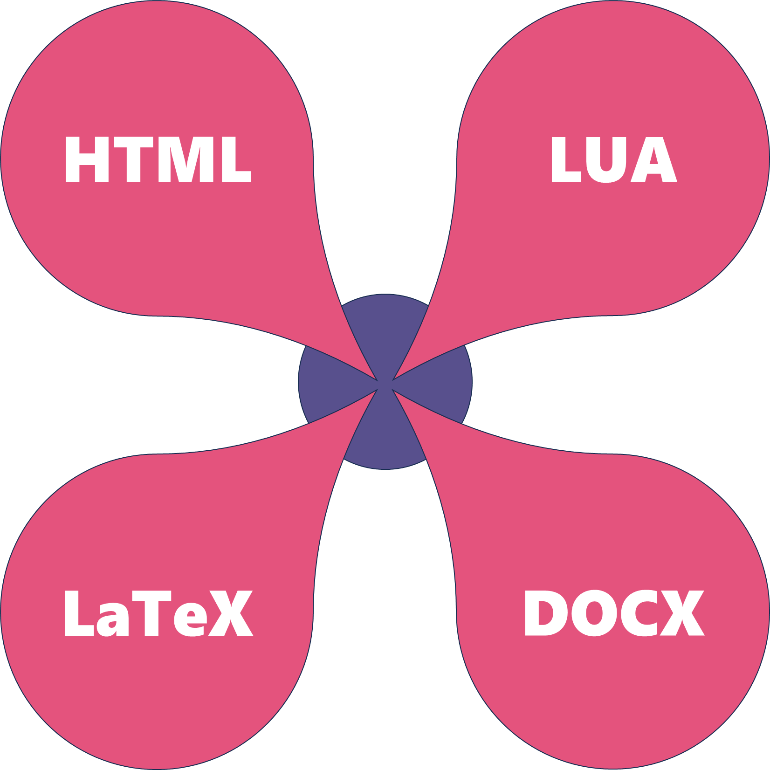
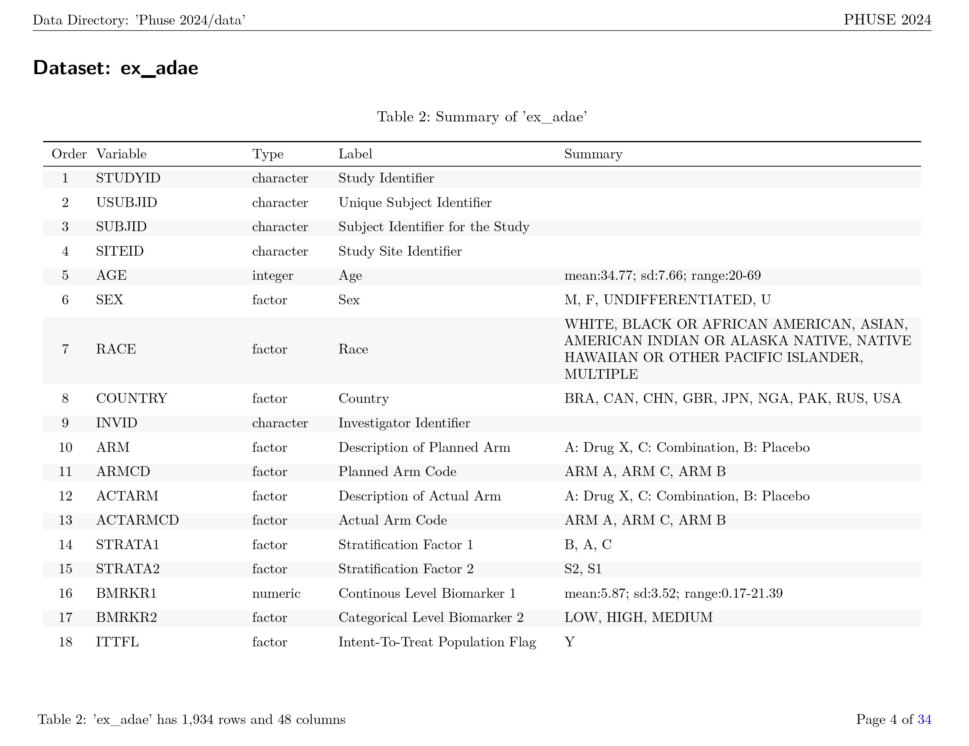


#ffa600
#58508d
#e4537d
Quarto and custom templates let you create high-quality reporting documents with style
Custom Templates
Custom Templates: Create a standard style template once, reuse it forever for all clinical reports
LaTeX templates for PDF documents
HTML templates for interactive documents
DOCX templates for Word documents
LUA filters to create your own flexible rendering operations
Repeatable Reports: Quarto is “the next generation of RMarkdown”, allowing you to:
Design a report once, and endlessly rerun it with updated data
Include written text alongside tables, figures, and raw code
Run code and view output from R, Python, Julia, and Observable in the same report
Output can be in the form of: RTF, Word, PDF, interactive dashboards, presentations, and more
Use Case
Use Quarto, LaTeX, and R
Recursively scan a directory full of datasets
Summarize data with variable name, type, label, and value summary
Create summary table with LaTeX
Automatically create table headers and footers
Output report as PDF
Kevin Putschko
Getting Started with Quarto, PP06

